Slide 1
SQL-on-Hadoop Tutorial VLDB 2015

Slide 2




Presenters
2
Fatma Özcan
IBM Research
IBM Big SQL
Daniel Abadi Yale University and Teradata
HadoopDB/Hadapt
Ippokratis Pandis Cloudera
Cloudera Impala
Shivnath Babu Duke University
Starfish

Slide 3
Why SQL-on-Hadoop?
People need to process data in parallel
Hadoop is by far the leading open source parallel data processing platform
Low costs of HDFS results in heavy usage
Lots of data in Hadoop with appetite to process it

Slide 4
MapReduce is not the answer
MapReduce is a powerful primitive to do many kinds of parallel data processing
BUT
Little control of data flow
Fault tolerance guarantees not always necessary
Simplicity leads to inefficiencies
Does not interface with existing analysis software
Industry has existing training in SQL
SQL interface for Hadoop critical for mass adoption

Slide 5
The database community knows how to process data
Decades of research in parallel database systems
Efficient data flow
Load balancing in the face of skew
Query optimization
Vectorized processing
Dynamic compilation of query operators
Co-processing of queries
Massive talent war between SQL-on-Hadoop companies for members of database community

Slide 6
SQL-on-Hadoop is not a direct implementation of parallel DBMSs
Little control of storage
Most deployments must be over HDFS
Append-only file system
Must support many different storage formats
Avro, Parquet, RCFiles, ORC, Sequence Files
Little control of metadata management
Optimizer may have limited access to statistics
Little control of resource management
YARN still in its infancy

Slide 7
SQL-on-Hadoop is not a direct implementation of parallel DBMSs
Hadoop often used a data dump (swamp?)
Data often unclean, irregular, and unreliable
Data not necessarily relational
HDFS does not enforce structure in the data
Nested data stored as JSON extremely popular
Scale larger than previous generation parallel database systems
Fault tolerance vs. query performance
Most Hadoop components written in Java
Want to play nicely with the entire Hadoop ecosystem

Slide 8
Outline of Tutorial
This session [13:30-15:00]
SQL-on-Hadoop Technologies
Storage
Run-time engine
Query optimization
Q&A
Second Session [15:30-17:00]
SQL-on-Hadoop examples
HadoopDB/Hadapt
Presto
Impala
BigSQL
SparkSQL
Phoenix/Spice Machine
Research directions
Q&A

Slide 9
Storage

Slide 10
Quick Look at HDFS
NameNode
DataNode
DataNode
…
DataNode

Slide 11
HDFS is
Good for
Storing large files
Write once and read many times
“Cheap” commodity hardware
Not good for
Low-latency reads
Short-circuit reads and HDFS caching help
Large amounts of small files
Multiple writers

Slide 12
In-situ Data Processing
HDFS as the data dump
Store the data first, figure out what to do later
Most data arrive in text format
Transform, cleanse the data
Create data marts in columnar formats
Lost of nested, JSON data
Some SQL in data transformations, but mostly other languages, such as Pig, Cascading, etc..
Columnar formats are good for analytics

Slide 13










SQL-on-Hadoop according to storage formats
Most SQL-on-Hadoop systems do not control or own the data
Hive, Impala, Presto, Big SQL, Spark SQL, Drill
Other SQL-on-Hadoop systems tolerate HDFS data, but work better with their own proprietary storage
HadoopDB/Hadapt
HAWQ, Actian Vortex, and HP Vertica

Slide 14
Query Processors with HDFS Native Formats
Only support native Hadoop formats with open-source reader/writers
Any Hadoop tool can generate their data
Pig, Cascading and other ETL tools
They are more of a query processor than a database
Indexing is a challenge !!
No co-location of multiple tables
Due to HDFS

Slide 15
Systems with Proprietary Formats
Almost all exploit some existing database systems
They store their own binary format on HDFS
Hadapt stores the data in a single node database, like postgres
Can exploit Postgres indexes
HAWQ, Actian, HP Vertica, and Hadapt all control how tables are partitioned, and can support co-located joins

Slide 16
HDFS Native Formats
CSV files are most common for ETL-like workloads
Lots of nested and complex data
Arrays, structs, maps, collections
Two major columnar formats
ORCFile
Parquet
Data serialization
JSON and Avro
Protocol buffers and Thrift

Slide 17
Parquet
PAX format, supporting nested data
Idea came from the Google‘s Dremel System
Major contributors: Twitter & Cloudera
Provides dictionary encoding and several compressions
Preffered format for Impala, IBM Big SQL, and Drill
Can use Thrift or Avro to describe the schema
Columnar storage
Nested data
Fast compression
Schema projection
Efficient encoding
A natural schema
Flexible
Less duplication applying denormalization
17

Slide 18
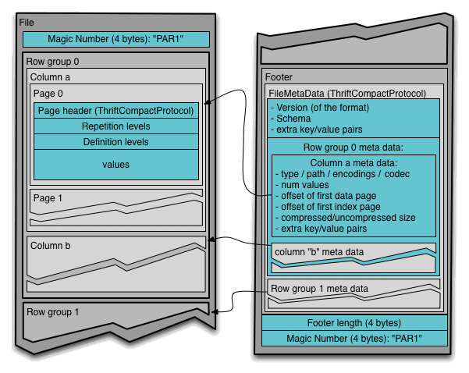
Parquet, cont.
A table with N columns is split into M row groups.
The file metadata contains the locations of all the column metadata start locations.
Metadata is written after the data to allow for single pass writing.
There are three types of metadata: file metadata, column (chunk) metadata and page header metadata.
Row group metadata includes
Min-max values for skipping
Notes:
https://github.com/Parquet/parquet-format

Slide 19
ORCFile
Second generation, following RC file
PAX formats with all data in a single file
Hortonworks is the major contributor, together with Microsoft
Preferred format for Hive, and Presto
Supports
Dictionary encoding
Fast compression
File, and stripe level metadata
Stripe indexing for skipping
Now metadata even includes bloom filters for point query lookups

Slide 20
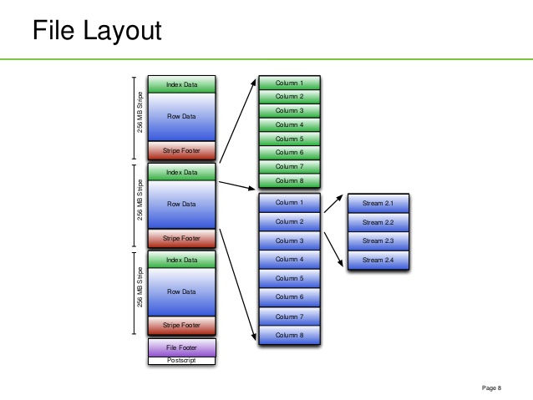
ORCFile Layout

Slide 21
Handling Updates in HDFS
No updates in HDFS
Appends to HDFS files are supported, but not clear how much they are used in production
Updates are collected in delta files
At the time of read delta and main files are merged
Special inputFormats
Lazy compaction to merge delta files and main files
When delta files reach a certain size
Scheduled intervals
delta 1
File A
delta 2
…
delta n

Slide 22
SQL on NoSQL!
Put a NoSQL solution on top of HDFS
For the record, you can avoid HDFS completely
But, this is a SQL-on-Hadoop tutorial
NoSQL solutions can provide CRUD at scale
CRUD = Create, Read, Update, Delete
And, then run SQL on it?
Sounds crazy? Well, lets see

Slide 23
HBase: The Hadoop Database
Not HadoopDB, which we will see later in the tutorial
HBase is a data store built on top of HDFS based on Google Bigtable
Data is logically organized into tables, rows, and columns
Although, Key-Value storage principles are used at multiple points in the design
Columns are organized into Column Families (CF)
Supports record-level CRUD, record-level lookup, random updates
Supports latency-sensitive operations

Slide 24
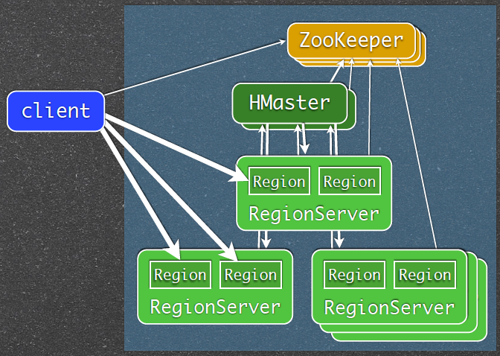
HBase Architecture

Slide 25
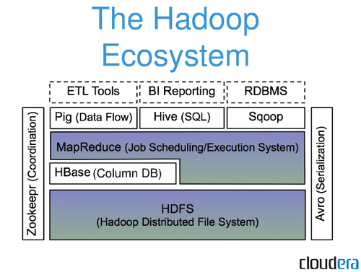
HBase Architecture
HBase stores three types of files
on HDFS:
WALs
HFiles
Links

Slide 26
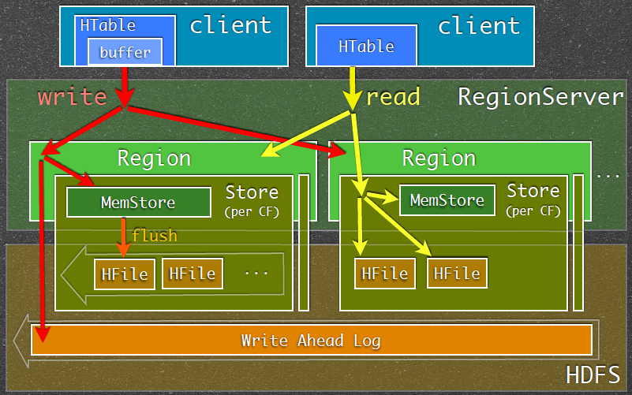
HBase Read and Write Paths

Slide 27
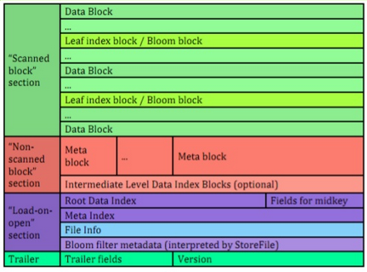
HFile Structure
HFile Format
Immutable
Created on flush or compaction
Sequential writes
Read randomly or sequentially
Data is in blocks
HFile blocks are not HDFS blocks
Default data block size == 64K
Default index block size == 128K
Default bloom filter block size
== 128K
Use smaller block sizes for
faster random lookup
Use larger block sizes for faster scans
Compression is recommended
Block encoding is recommended

Slide 28
Run-time Engine

Slide 29
Design Decisions: Influencers
Low Latency
High Throughput
Degree of tolerance to faults
Scalability in data size
Scalability in cluster size
Resource elasticity
Multi-tenancy
Ease of installation in existing environments
Notes:
http://www.slideshare.net/alanfgates/strata-stingertalk-oct2013 Slide 22 mentions Stripe-based Input Splits
Hive-5632 (Eliminate splits based on SARGs using stripe statistics in ORC): Includes a comment from committer:
ORC already stores hierarchical min/max metadata. At the lowest level, ORC stores min/max for every 10,000 rows (called as rowgroups). The size of the rowgroup can be configured using the table property "orc.row.index.stride". At a higher level, HIVE-5562 adds min/max metadata to stripe level. There is also file level min/max values as well at the file footer.Stripe levels stats are stored in file footer, stripes that doesn't satisfy the predicates can be skipped while computing the splits.

Slide 30
Accepted across SQL-on-Hadoop Solutions
Push computation to data
Columnar data formats
Vectorization
Support for multiple data formats
Support for UDFs
Notes:
http://www.slideshare.net/alanfgates/strata-stingertalk-oct2013 Slide 22 mentions Stripe-based Input Splits
Hive-5632 (Eliminate splits based on SARGs using stripe statistics in ORC): Includes a comment from committer:
ORC already stores hierarchical min/max metadata. At the lowest level, ORC stores min/max for every 10,000 rows (called as rowgroups). The size of the rowgroup can be configured using the table property "orc.row.index.stride". At a higher level, HIVE-5562 adds min/max metadata to stripe level. There is also file level min/max values as well at the file footer.Stripe levels stats are stored in file footer, stripes that doesn't satisfy the predicates can be skipped while computing the splits.

Slide 31
Differences across SQL-on-Hadoop Solutions
What is the Lowest Common Execution Unit
Use of Push Vs. Pull
On the JVM or not
Fault tolerance: Intra-query or inter-query
Support for multi-tenancy
Notes:
http://www.slideshare.net/alanfgates/strata-stingertalk-oct2013 Slide 22 mentions Stripe-based Input Splits
Hive-5632 (Eliminate splits based on SARGs using stripe statistics in ORC): Includes a comment from committer:
ORC already stores hierarchical min/max metadata. At the lowest level, ORC stores min/max for every 10,000 rows (called as rowgroups). The size of the rowgroup can be configured using the table property "orc.row.index.stride". At a higher level, HIVE-5562 adds min/max metadata to stripe level. There is also file level min/max values as well at the file footer.Stripe levels stats are stored in file footer, stripes that doesn't satisfy the predicates can be skipped while computing the splits.

Slide 32
SQL on MapReduce
Hive
Tenzing
Notes:
http://www.slideshare.net/alanfgates/strata-stingertalk-oct2013 Slide 22 mentions Stripe-based Input Splits
Hive-5632 (Eliminate splits based on SARGs using stripe statistics in ORC): Includes a comment from committer:
ORC already stores hierarchical min/max metadata. At the lowest level, ORC stores min/max for every 10,000 rows (called as rowgroups). The size of the rowgroup can be configured using the table property "orc.row.index.stride". At a higher level, HIVE-5562 adds min/max metadata to stripe level. There is also file level min/max values as well at the file footer.Stripe levels stats are stored in file footer, stripes that doesn't satisfy the predicates can be skipped while computing the splits.

Slide 33
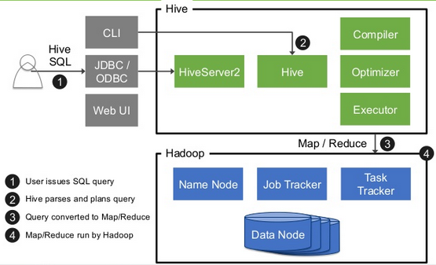
Hive
Notes:
http://www.slideshare.net/alanfgates/strata-stingertalk-oct2013 Slide 22 mentions Stripe-based Input Splits
Hive-5632 (Eliminate splits based on SARGs using stripe statistics in ORC): Includes a comment from committer:
ORC already stores hierarchical min/max metadata. At the lowest level, ORC stores min/max for every 10,000 rows (called as rowgroups). The size of the rowgroup can be configured using the table property "orc.row.index.stride". At a higher level, HIVE-5562 adds min/max metadata to stripe level. There is also file level min/max values as well at the file footer.Stripe levels stats are stored in file footer, stripes that doesn't satisfy the predicates can be skipped while computing the splits.

Slide 34
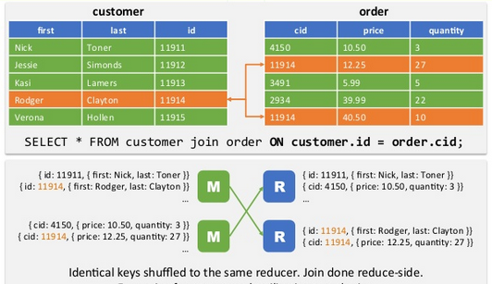
Example: Joins in MapReduce
Notes:
http://www.slideshare.net/alanfgates/strata-stingertalk-oct2013 Slide 22 mentions Stripe-based Input Splits
Hive-5632 (Eliminate splits based on SARGs using stripe statistics in ORC): Includes a comment from committer:
ORC already stores hierarchical min/max metadata. At the lowest level, ORC stores min/max for every 10,000 rows (called as rowgroups). The size of the rowgroup can be configured using the table property "orc.row.index.stride". At a higher level, HIVE-5562 adds min/max metadata to stripe level. There is also file level min/max values as well at the file footer.Stripe levels stats are stored in file footer, stripes that doesn't satisfy the predicates can be skipped while computing the splits.

Slide 35
Limitations
Having a MapReduce Job as the Lowest Execution Unit quickly becomes restrictive
Query execution plans become MapReduce workflows
Notes:
http://www.slideshare.net/alanfgates/strata-stingertalk-oct2013 Slide 22 mentions Stripe-based Input Splits
Hive-5632 (Eliminate splits based on SARGs using stripe statistics in ORC): Includes a comment from committer:
ORC already stores hierarchical min/max metadata. At the lowest level, ORC stores min/max for every 10,000 rows (called as rowgroups). The size of the rowgroup can be configured using the table property "orc.row.index.stride". At a higher level, HIVE-5562 adds min/max metadata to stripe level. There is also file level min/max values as well at the file footer.Stripe levels stats are stored in file footer, stripes that doesn't satisfy the predicates can be skipped while computing the splits.

Slide 36
MapReduce Workflows
D0₁
D0₂
Datasets
J1
J2
D1
D2
MapReduce Jobs
J3
D3
J4
D4
J5
J6
D5
D6
J7
D7
Notes:
Companies, researchers, etc use workflows to do data analytics. MapReduce is a popular choice for running Workflows. This is an example of a 7 –job MapReduce workflows. MapReduce jobs with prod-consumer relationship
Tall person… basic idea when most people write workflow, they focus on the operators, which result in tall and thing workflows. We want it to be short and broad by packing functions into smaller number of jobs
Big Performance Gap between Unoptimized
Contribution: Stubby.. Automatic optimization
Stubby! Turns the 7 job workflow into a 2job workflow

Slide 37
Research Done to Address these Limitations
On efficient joins in the MapReduce paradigm
On reducing the number of MapReduce jobs by packing/collapsing the MapReduce workflow
Horizontally
Shared scans
Vertically
Making using of static and dynamic partitioning
On efficient management of intermediate data
Notes:
http://www.slideshare.net/alanfgates/strata-stingertalk-oct2013 Slide 22 mentions Stripe-based Input Splits
Hive-5632 (Eliminate splits based on SARGs using stripe statistics in ORC): Includes a comment from committer:
ORC already stores hierarchical min/max metadata. At the lowest level, ORC stores min/max for every 10,000 rows (called as rowgroups). The size of the rowgroup can be configured using the table property "orc.row.index.stride". At a higher level, HIVE-5562 adds min/max metadata to stripe level. There is also file level min/max values as well at the file footer.Stripe levels stats are stored in file footer, stripes that doesn't satisfy the predicates can be skipped while computing the splits.

Slide 38
From MapReduce to DAGs
Dryad
Tez
Notes:
http://www.slideshare.net/alanfgates/strata-stingertalk-oct2013 Slide 22 mentions Stripe-based Input Splits
Hive-5632 (Eliminate splits based on SARGs using stripe statistics in ORC): Includes a comment from committer:
ORC already stores hierarchical min/max metadata. At the lowest level, ORC stores min/max for every 10,000 rows (called as rowgroups). The size of the rowgroup can be configured using the table property "orc.row.index.stride". At a higher level, HIVE-5562 adds min/max metadata to stripe level. There is also file level min/max values as well at the file footer.Stripe levels stats are stored in file footer, stripes that doesn't satisfy the predicates can be skipped while computing the splits.

Slide 39
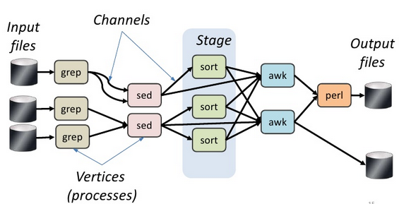
Dryad: Dataflows as First-class Citizens
Notes:
http://www.slideshare.net/alanfgates/strata-stingertalk-oct2013 Slide 22 mentions Stripe-based Input Splits
Hive-5632 (Eliminate splits based on SARGs using stripe statistics in ORC): Includes a comment from committer:
ORC already stores hierarchical min/max metadata. At the lowest level, ORC stores min/max for every 10,000 rows (called as rowgroups). The size of the rowgroup can be configured using the table property "orc.row.index.stride". At a higher level, HIVE-5562 adds min/max metadata to stripe level. There is also file level min/max values as well at the file footer.Stripe levels stats are stored in file footer, stripes that doesn't satisfy the predicates can be skipped while computing the splits.

Slide 40
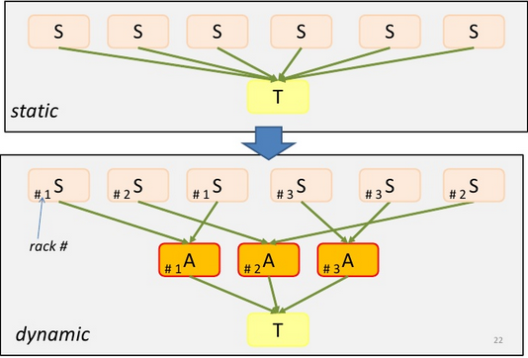
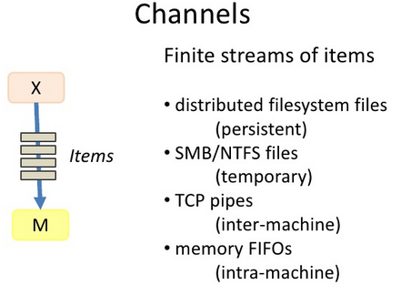
Smart DAG Execution in Dryad
Notes:
http://www.slideshare.net/alanfgates/strata-stingertalk-oct2013 Slide 22 mentions Stripe-based Input Splits
Hive-5632 (Eliminate splits based on SARGs using stripe statistics in ORC): Includes a comment from committer:
ORC already stores hierarchical min/max metadata. At the lowest level, ORC stores min/max for every 10,000 rows (called as rowgroups). The size of the rowgroup can be configured using the table property "orc.row.index.stride". At a higher level, HIVE-5562 adds min/max metadata to stripe level. There is also file level min/max values as well at the file footer.Stripe levels stats are stored in file footer, stripes that doesn't satisfy the predicates can be skipped while computing the splits.

Slide 41
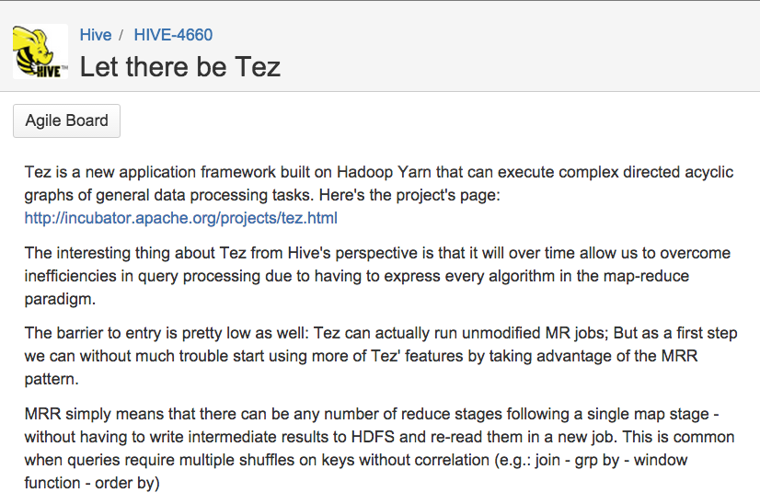
Tez: Inspired by Dryad and Powered by YARN
Notes:
http://www.slideshare.net/alanfgates/strata-stingertalk-oct2013 Slide 22 mentions Stripe-based Input Splits
Hive-5632 (Eliminate splits based on SARGs using stripe statistics in ORC): Includes a comment from committer:
ORC already stores hierarchical min/max metadata. At the lowest level, ORC stores min/max for every 10,000 rows (called as rowgroups). The size of the rowgroup can be configured using the table property "orc.row.index.stride". At a higher level, HIVE-5562 adds min/max metadata to stripe level. There is also file level min/max values as well at the file footer.Stripe levels stats are stored in file footer, stripes that doesn't satisfy the predicates can be skipped while computing the splits.

Slide 42
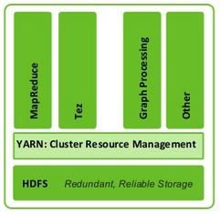
Quick Detour on YARN
The Hadoop Community realized that MapReduce cannot be the Lowest Execution Unit for all data apps
Separated out the resource management aspects from application management
YARN is best seen as an Operating System for Data Processing Apps
Recall the 80s: Databases and Operating Systems: Friends or Foes?
Notes:
http://www.slideshare.net/alanfgates/strata-stingertalk-oct2013 Slide 22 mentions Stripe-based Input Splits
Hive-5632 (Eliminate splits based on SARGs using stripe statistics in ORC): Includes a comment from committer:
ORC already stores hierarchical min/max metadata. At the lowest level, ORC stores min/max for every 10,000 rows (called as rowgroups). The size of the rowgroup can be configured using the table property "orc.row.index.stride". At a higher level, HIVE-5562 adds min/max metadata to stripe level. There is also file level min/max values as well at the file footer.Stripe levels stats are stored in file footer, stripes that doesn't satisfy the predicates can be skipped while computing the splits.

Slide 43
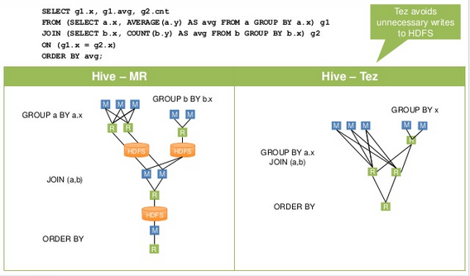
An Example of What Tez Enables
Notes:
http://www.slideshare.net/alanfgates/strata-stingertalk-oct2013 Slide 22 mentions Stripe-based Input Splits
Hive-5632 (Eliminate splits based on SARGs using stripe statistics in ORC): Includes a comment from committer:
ORC already stores hierarchical min/max metadata. At the lowest level, ORC stores min/max for every 10,000 rows (called as rowgroups). The size of the rowgroup can be configured using the table property "orc.row.index.stride". At a higher level, HIVE-5562 adds min/max metadata to stripe level. There is also file level min/max values as well at the file footer.Stripe levels stats are stored in file footer, stripes that doesn't satisfy the predicates can be skipped while computing the splits.

Slide 44
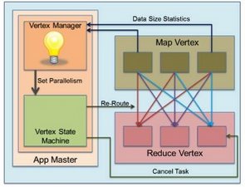
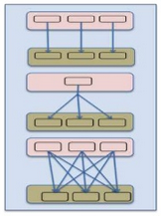
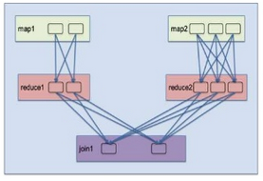
A Tez Slide on Tez
Notes:
http://www.slideshare.net/alanfgates/strata-stingertalk-oct2013 Slide 22 mentions Stripe-based Input Splits
Hive-5632 (Eliminate splits based on SARGs using stripe statistics in ORC): Includes a comment from committer:
ORC already stores hierarchical min/max metadata. At the lowest level, ORC stores min/max for every 10,000 rows (called as rowgroups). The size of the rowgroup can be configured using the table property "orc.row.index.stride". At a higher level, HIVE-5562 adds min/max metadata to stripe level. There is also file level min/max values as well at the file footer.Stripe levels stats are stored in file footer, stripes that doesn't satisfy the predicates can be skipped while computing the splits.

Slide 45
Spark: A Different Way to Look at a Dataflow
sc.textFile(hdfsPath)
.map(parseInput)
.filter(subThreshold)
.reduceByKey(tallyCount)
.map(formatOutput)
.saveAsTextFile(outPath)
part-0
part-0
part-0
part-0
part-0
part-0
part-1
part-1
part-1
part-1
part-1
part-1
part-2
part-2
part-2
part-2
part-2
part-2
part-3
part-3
part-3
part-3
part-3
part-3
RDD0
RDD1
RDD2
RDD3
RDD4
HDFS
map
filter
reduceBykey
map
saveAsTextFile

Slide 46
Spark: A Different Way to Look at a Dataflow
Stage 0
Stage 1
sc.textFile(hdfsPath)
.map(parseInput)
.filter(subThreshold)
.reduceByKey(tallyCount)
.map(formatOutput)
.saveAsTextFile(outPath)
part-0
part-0
part-0
part-0
part-0
part-0
part-1
part-1
part-1
part-1
part-1
part-1
part-2
part-2
part-2
part-2
part-2
part-2
part-3
part-3
part-3
part-3
part-3
part-3
RDD0
RDD1
RDD2
RDD3
RDD4
HDFS
map
reduceBykey
saveAsTextFile
filter
map

Slide 47
Spark: A Different Way to Look at a Dataflow
Stage 0
Stage 1
Task0
Task0
sc.textFile(hdfsPath)
.map(parseInput)
.filter(subThreshold)
.reduceByKey(tallyCount)
.map(formatOutput)
.saveAsTextFile(outPath)
part-0
part-0
part-0
part-0
part-0
part-0
Task1
Task1
part-1
part-1
part-1
part-1
part-1
part-1
Task2
Task2
part-2
part-2
part-2
part-2
part-2
part-2
Task3
Task3
part-3
part-3
part-3
part-3
part-3
part-3
map
RDD0
RDD1
RDD2
RDD3
RDD4
HDFS
map
filter
reduceBykey
saveAsTextFile

Slide 48
Spark: A Different Way to Look at a Dataflow
Stage 0
Stage 1
sc.textFile(hdfsPath)
.map(parseInput)
.filter(subThreshold)
.reduceByKey(tallyCount)
.map(formatOutput)
.saveAsTextFile(outPath)
part-0
part-0
part-0
part-0
part-0
part-0
Exec0
Exec1
part-1
part-1
part-1
part-1
part-1
part-1
Exec2
part-2
part-2
part-2
part-2
part-2
part-2
Exec3
part-3
part-3
part-3
part-3
part-3
part-3
RDD0
RDD1
RDD2
RDD3
RDD4
HDFS
map
filter
reduceBykey
map
saveAsTextFile

Slide 49
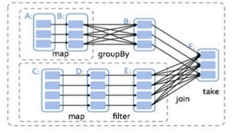
Spark: A Different Way to Look at a Dataflow
Notes:
http://www.slideshare.net/alanfgates/strata-stingertalk-oct2013 Slide 22 mentions Stripe-based Input Splits
Hive-5632 (Eliminate splits based on SARGs using stripe statistics in ORC): Includes a comment from committer:
ORC already stores hierarchical min/max metadata. At the lowest level, ORC stores min/max for every 10,000 rows (called as rowgroups). The size of the rowgroup can be configured using the table property "orc.row.index.stride". At a higher level, HIVE-5562 adds min/max metadata to stripe level. There is also file level min/max values as well at the file footer.Stripe levels stats are stored in file footer, stripes that doesn't satisfy the predicates can be skipped while computing the splits.

Slide 50
Fault Tolerance

Slide 51
MapReduce Fault Tolerance
Map
Map
Reduce
Reduce
Map
Map
HDFS
Reduce
HDFS
Reduce
Map
Map
Reduce
Reduce
Map
Map
Reduce
Reduce
Map
Map

Slide 52
MapReduce Fault Tolerance
Map
Map
Reduce
Reduce
Map
Map
HDFS
Reduce
HDFS
Reduce
Map
Map
Reduce
Reduce
Map
Map
Reduce
Reduce
Map
Map

Slide 53
MapReduce Fault Tolerance
Map
Map
Reduce
Reduce
Map
Map
HDFS
Reduce
HDFS
Reduce
Map
Map
Reduce
Reduce
Map
Map
Reduce
Reduce
Map
Map

Slide 54
MapReduce Fault Tolerance
Map
Map
Reduce
Reduce
Map
Map
HDFS
Reduce
HDFS
Reduce
Map
Map
Reduce
Reduce
Map
Map
Reduce
Reduce
Map
Map

Slide 55
MapReduce Fault Tolerance
Map
Map
Reduce
Reduce
Map
Map
HDFS
Reduce
HDFS
Reduce
Map
Map
Reduce
Reduce
Map
Map
Reduce
Reduce
Map
Map

Slide 56
MapReduce Fault Tolerance
Map
Map
Reduce
Reduce
Map
Map
HDFS
Reduce
HDFS
Reduce
Map
Map
Reduce
Reduce
Map
Map
Reduce
Reduce
Map
Map

Slide 57
Fault Tolerance
SELECT sourceIP, SUM(adRevenue) FROM UserVisits GROUP BY sourceIP
Node fails (or slows down by factor of 2) in the middle of query

Slide 58
Downsides of MapReduce Fault Tolerance
Map output written to disk
Reduce output written to HDFS
Map
Map
Reduce
Reduce
Map
Map
HDFS
Reduce
HDFS
Reduce
Map
Map
Reduce
Reduce
Map
Map
Reduce
Reduce
Map
Map

Slide 59
Spark RDDs
Stores intermediate results in memory rather than disk
Advantage: Performance
Disadvantage: Memory requirements

Slide 60
Resource Management

Slide 61
Resource Management
(At least) Two dimension problem:
RM across different frameworks
Usually not a dedicated cluster
Shared across multiple frameworks
ETL (MapReduce, Spark), Hbase
SQL-on-Hadoop processing
RM across concurrent queries

Slide 62
RM -- Across frameworks
YARN – Yet Another Resource Negotiator
Centralized, cluster-wide resource management system
Allows frameworks to share resources without partitioning between them
Designed for batch-mostly processing
Not mature
Not good for interactive analytics
Not meant for long running processes
Approaches: Llama and Slider

Slide 63
RM -- LLAMA (low-latency application master)
Introduced by Cloudera
LLAMA acts as a proxy between Impala and YARN
Mitigates some of the batch-centric design aspects of YARN:
High resource acquisition latency -> solves via resource caching
Resource request is immutable -> solves via expansion request
Resource allocation is incremental -> solves via gang scheduling
Notes:
Pay the conversion price once for query many times workloads.
What data type for DECIMAL data?
Dates probably stored as STRING in YYYY-MM-DD format
Optionally stored as INTs
Removed:
For DECIMAL data use FLOAT/DOUBLE

Slide 64
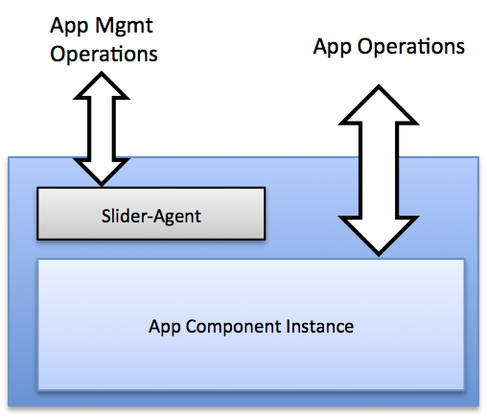
RM -- Apache Slider
64
Slider allows running non-YARN enabled applications on YARN
Without having to write your own custom Application Master
Existing applications are packaged as Slider applications
Encapsulates a set of one or more application components or roles
Deployed by Slider, runs in containers across a YARN cluster
Pre-built packages for HBase, Accumulo, Storm, and jmemcached
Packages need to be custom built for other applications
Some notable Slider features
Applications can be stopped and started later → state is persisted
Container failures are automatically detected by Slider and restarted

Slide 65
Query Optimization

Slide 66
Some Techniques We Know and Love Are not Directly Applicable
Indexing
Zone-maps
Co-located joins
Query rewrites
Cost-based optimization
Databases own their storage SQL-on-Hadoop systems do not
Metadata management is tricky
Data inserted/loaded without SQL system knowledge
No co-location of related tables
HDFS is for most practical purposes, read-only

Slide 67
I/O Elimination for HDFS Data: Partition-level
Hive Partition tables maintain metadata values as one folder/ directory in HDFS, per distinct value:
Example: PARTITIONED BY (country STRING, year INT, month INT, day INT) ;
Folder/Directory created for country=US/year=2012/month=12/day=22
Partitioning only logical, not physical
Partition pruning eliminates reading files that are not needed
Almost all SQL-on-Hadoop offerings support this
Hive, Impala, SparkSQL, IBM BigSQL, ….
Notes:
http://www.slideshare.net/alanfgates/strata-stingertalk-oct2013 Slide 22 mentions Stripe-based Input Splits
Hive-5632 (Eliminate splits based on SARGs using stripe statistics in ORC): Includes a comment from committer:
ORC already stores hierarchical min/max metadata. At the lowest level, ORC stores min/max for every 10,000 rows (called as rowgroups). The size of the rowgroup can be configured using the table property "orc.row.index.stride". At a higher level, HIVE-5562 adds min/max metadata to stripe level. There is also file level min/max values as well at the file footer.Stripe levels stats are stored in file footer, stripes that doesn't satisfy the predicates can be skipped while computing the splits.

Slide 68
I/O Elimination for HDFS Data: Rowblock-level
ORCFile broken into Stripes (250MB default)
Index with Min/Max values stored for each Column
Data is a “stream” of columns
Bloom filters for each stripe in ORCFile allow fast lookups
Parquet also supports min/max values
Works well when data is sorted, not very effective otherwise

Slide 69
Quick look at query optimizers
Two types of optimization
Logical transformations to transform query into equivalent but simpler form
Cost-based enumeration of alternative execution plans
Most systems support the first one
Cost-based optimization depends on good statistics and a good model of the execution environment
Without controlling data storage, statistics are “gestimates”

Slide 70
Query Rewrite
Selection/projection pushdown
Nested SQL queries require more sophisticated rewrites, such as decorrelation
New systems all have rewrites but lack complex decorrelation and subquery optimization ones
Hive, Impala, Presto, Spark SQL
Systems that leverage mature DB technology offer more sophisticated rewrite engines
IBM SQL, Hadapt, HP Vertica

Slide 71
Cost-based Optimization
Hive analyze table collects basic statistics
Column value distributions, min-max, no-of-distinct values
No control of data → data changes without the systems’ knowledge
Multi-tenant system makes it harder to build a cost model
More complex system behavior
More adaptive query processing is needed

Slide 72
Co-located joins
Co-partitioning two tables on the join key enables local joins
HDFS default block placement policy scatters blocks in the cluster
Actian Vortex changes HDFS default block placement to enforce co-located joins
File A
File B
File C
File D
Files A & B are co-located
Files C & D are co-located

Slide 73
Outline of Tutorial
This session [13:30-15:00]
SQL-on-Hadoop Technologies
Storage
Run-time engine
Query optimization
Q&A
Second Session [15:30-17:00]
SQL-on-Hadoop examples
HadoopDB/Hadapt
Presto
Impala
BigSQL
SparkSQL
Phoenix/Spice Machine
Research directions
Q&A

Slide 74
HadoopDB
First of avalanche of SQL-on-Hadoop solutions to claim 100x faster than Hive (on certain types of queries)
Used Hadoop MapReduce to coordinate execution of multiple independent (typically single node, open source) database systems
Maintained MapReduce’s fault tolerance
Sped up single-node processing via leveraging database performance optimizations:
Compression
Vectorization
Partitioning
Column-orientation
Query optimization
Broadcast joins
Flexible query interface (both SQL and MapReduce)

Slide 75
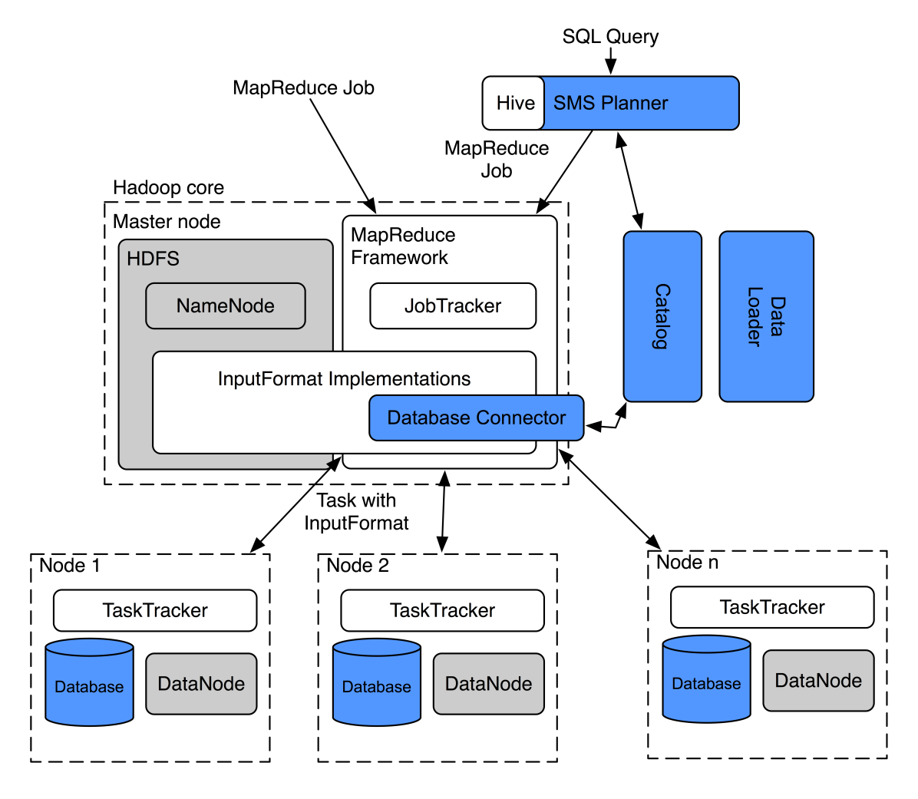
HadoopDB Architecture

Slide 76
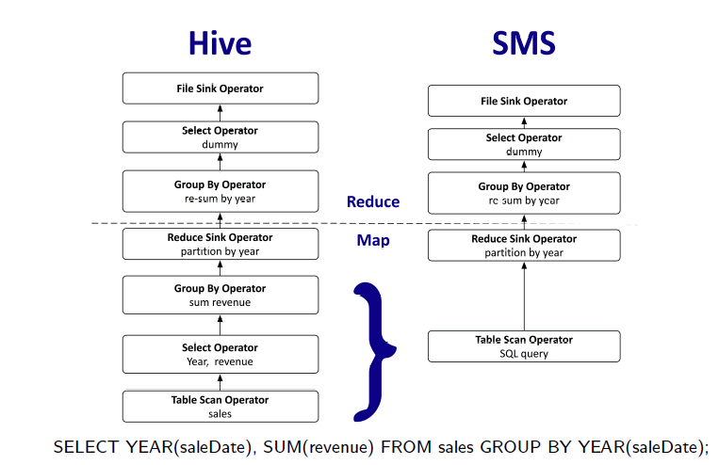
HadoopDB SMS Planner

Slide 77
HadoopDB History
Paper published in 2009
Company founded in 2010 (Hadapt) to commercialize HadoopDB
Added support for search in 2011 (for major insurance customer)
Added JSON support in 2012
Added interactive query engine in 2013
Acquired by Teradata in 2014

Slide 78
Teradata Unified Data Architecture: QueryGrid
Marketing Executives
Operational Systems
Customers & Partners
Frontline Workers
Business Analysts
Data Scientists
Engineers &
Programmers
Teradata or Aster Database
Teradata QUeryGrid
Push down / remote processing
SQL-H
SQL
SQL
SQL, NOSQL
VARIOUS
DATA PLATFORM
INTEGRATED DATA WAREHOUSE
Discovery platform
Other
Databases
Compute
Clusters
Hadoop or
Teradata
Teradata
Database
Aster
Database
Oracle, MongoDB, etc
SAS, PYTHON,
R, PERL, RUBY…

Slide 79
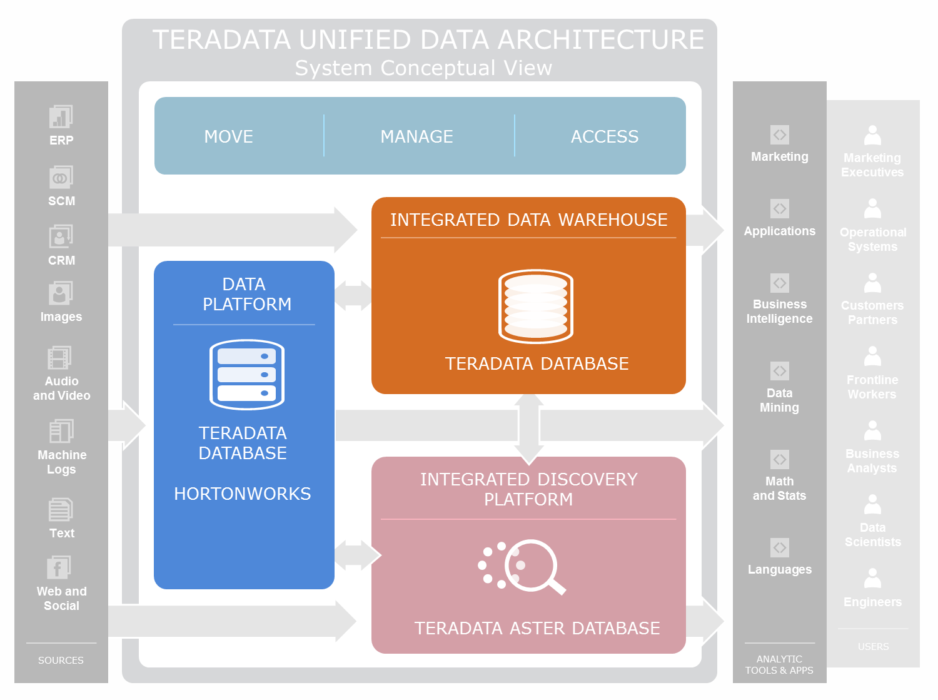

Remote Processing On Hadoop
Query through Teradata
Leaves of query plan sent to SQL-on-Hadoop engine
Results returned to Teradata
Additional query processing done in Teradata
Final results sent back to application/user
Teradata 15.0

Slide 80
Teradata QueryGrid Teradata-Hadoop
Bi-directional data movement
Read and write data to Hadoop
Create new table in Hadoop or insert records
Query push-down
Execute query on Hadoop
Qualify rows and columns to reduce data returned
Easy configuration and simplified queries
Create “Hadoop server” definition once
Use @foreign_server name to access Hadoop

Slide 81

History of Presto
SPRING 2015
Teradata provides first commercial support for Presto + roadmap
FALL 2014
88 releases 41 contributors 3943 commits
FALL 2013
Facebook open sources Presto
SPRING 2013
Presto rolled out within Facebook
FALL 2012
6 developers start Presto development
FALL 2008
Facebook open sources Hive

Slide 82
Hive
Presto
Reduce
Reduce
Task
All stages are pipelined
Reduced wait time
No Fault Tolerance
Wait
between
stages
Disk
Map
Map
Task
Task
Disk
Memory-to-memory
Data transfer
No disc IO
Data chunk must
fit in memory
Reduce
Reduce
Task
Task
Disk
Map
Map
Task
Task
Write to Disk
Fault Tolerance
IO Overhead

Slide 83

Presto at a Glance
Written in Java
100% ANSI SQL goal
Numerous built-in functions
Window functions
Array/map support
Plug-in architecture
Join across data stores
Hive, Cassandra, Kafka, MySQL
Amazon S3
Uses Hive metastore
Bytecode query compilation
Approximate queries
Return X% sample rows
Limitations
Manual join SQL ordering
Non-equi joins not supported
Not YARN enabled
No Avro support
No spill-to-disk

Slide 84

Presto Pipeline Architecture
Metadata
API
Data Location API
Coordinator
Parser/
analyzer
Client
Planner
Scheduler
Worker
Worker
Data stream API
Worker
Data stream API

Slide 85







Presto Connectors
Client
Presto Coordinator
Presto worker
Presto worker
Presto worker
Presto worker

Slide 86

Github: Presto Plug-in Connectors
Hive tables and HCatalog
Apache Cassandra
Apache Kafka
Kafka topics = Presto tables, messages = rows
MySQL
Single node access only -- no sharding
Postgres
Single node access only
HBase
not released

Slide 87
Cloudera Impala

Slide 88
Query execution at the high level
88
SQL App
Hive Metastore
HDFS NameNode
Statestore
Catalog
ODBC
SQL request
Results
Impalad
Impalad
Impalad
Query Planner
Query Planner
Query Planner
Plan Fragments
Query Coordinator
Query Coordinator
Query Coordinator
Query Executor
Query Executor
Query Executor
HDFS DN
HBase
HDFS DN
HBase
HDFS DN
HBase

Slide 89
Query Planning: Distributed Plans
TopN
Merge
TopN
TopN
Single-Node
Plan
MergeAgg
Agg
at HDFS DN
hash t1.custid
at HBase RS
HashJoin
Scan: t3
Pre-Agg
at coordinator
HashJoin
Scan: t2
HashJoin
Broadcast
Scan: t3
Scan: t1
Scan: t1
hash t1.id1
HashJoin
hash t2.id
Scan: t2
Notes:
Pay the conversion price once for query many times workloads.
What data type for DECIMAL data?
Dates probably stored as STRING in YYYY-MM-DD format
Optionally stored as INTs
Removed:
For DECIMAL data use FLOAT/DOUBLE

Slide 90
Execution Engine
Written in C++ for minimal cycle and memory overhead
Leverages decades of parallel DB research
Partitioned parallelism
Pipelined relational operators
Batch-at-a-time runtime
Focussed on speed and efficiency
Intrinsics/machine code for text parsing, hashing, etc.
Runtime code generation with LLVM
Notes:
Pay the conversion price once for query many times workloads.
What data type for DECIMAL data?
Dates probably stored as STRING in YYYY-MM-DD format
Optionally stored as INTs
Removed:
For DECIMAL data use FLOAT/DOUBLE

Slide 91
Runtime Code Generation
Uses llvm to jit-compile the runtime-intensive parts of a query
Effect the same as custom-coding a query:
Remove branches, unroll loops
Propagate constants, offsets, pointers, etc.
Inline function calls
Optimized execution for modern CPUs (instruction pipelines)
Notes:
Pay the conversion price once for query many times workloads.
What data type for DECIMAL data?
Dates probably stored as STRING in YYYY-MM-DD format
Optionally stored as INTs
Removed:
For DECIMAL data use FLOAT/DOUBLE

Slide 92
Runtime Code Generation — Example
IntVal my_func(const IntVal& v1, const IntVal& v2) {
return IntVal(v1.val * 7 / v2.val);
}
SELECT my_func(col1 + 10, col2) FROM ...
function pointer
my_func
function pointer
function pointer
+
col2
(col1 + 10) * 7 / col2
function pointer
function pointer
col1
10
interpreted
codegen’d
Notes:
Pay the conversion price once for query many times workloads.
What data type for DECIMAL data?
Dates probably stored as STRING in YYYY-MM-DD format
Optionally stored as INTs
Removed:
For DECIMAL data use FLOAT/DOUBLE

Slide 93
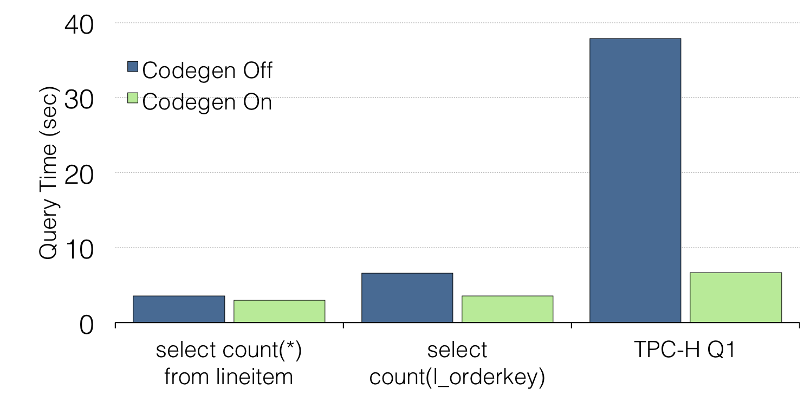
Impala Runtime Code Generation - Performance
10 node cluster (12 disks / 48GB RAM / 8 cores per node)
~40 GB / ~60M row Avro dataset
Notes:
Pay the conversion price once for query many times workloads.
What data type for DECIMAL data?
Dates probably stored as STRING in YYYY-MM-DD format
Optionally stored as INTs
Removed:
For DECIMAL data use FLOAT/DOUBLE

Slide 94
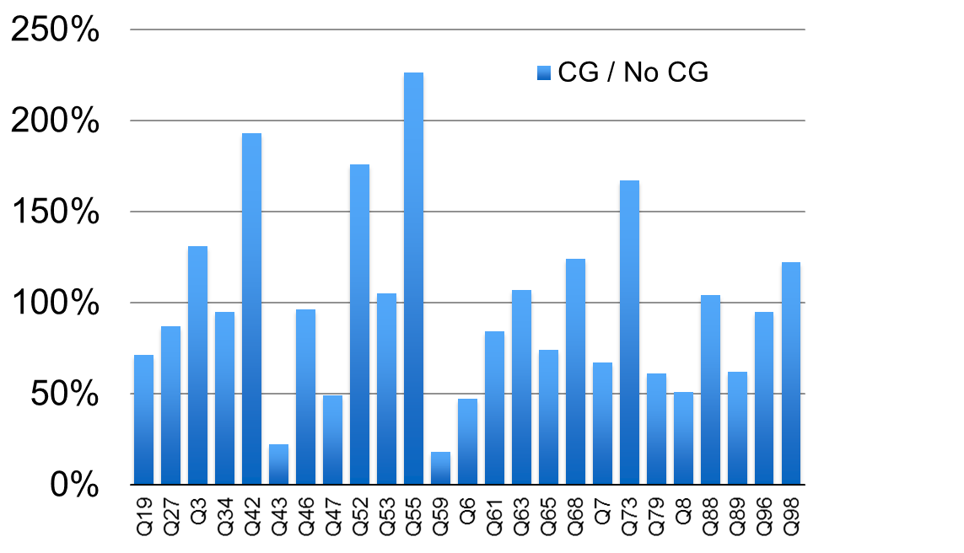
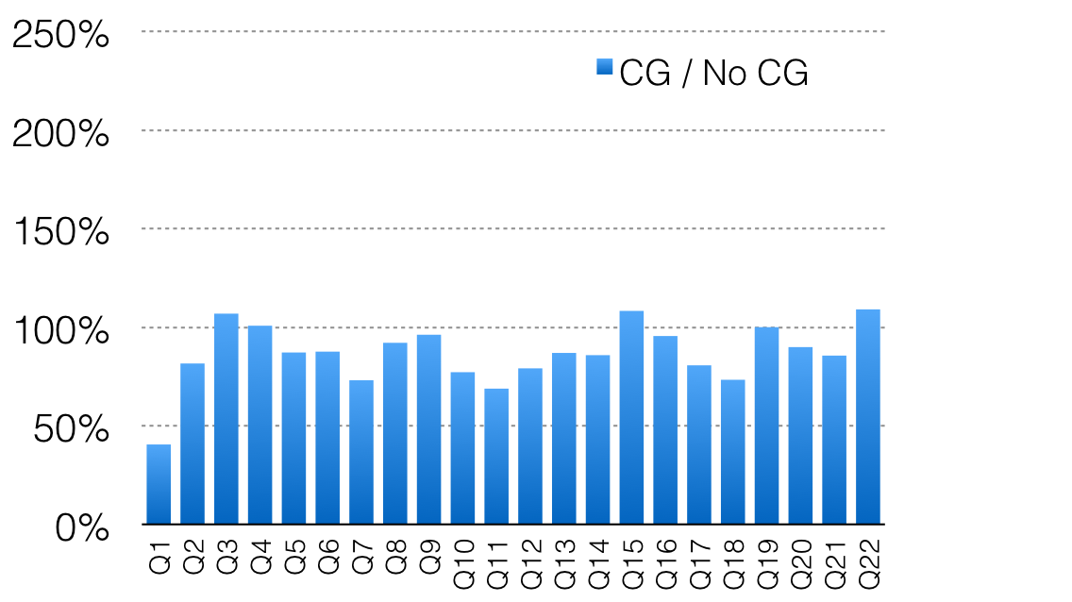
Codegen is not the panacea!
TPC-H 300GB,10-node cluster
TPC-DS 500GB,10-node cluster

Slide 95
Resource Management in Impala
Admission control and Yarn-based RM cater to different workloads
Use admission control for:
Low-latency, high-throughput workloads
Mostly running Impala, or resource partitioning is feasible
Use Llama/Yarn for:
Mixed workloads (Impala, MR, Spark, …) and resource partitioning is impractical
Latency and throughput SLAs are relatively relaxed

Slide 96
Roadmap: Impala 2.3+
Nested data: Structs, arrays, maps in Parquet, Avro, JSON, …
Natural extension of SQL: expose nested structures as tables
No limitation on nesting levels or number of nested fields in single query
Multithreaded execution past scan operator
Resource management and admission control
low-latency, high-throughput mixed workloads without resource partitioning
More SQL: ROLLUP/GROUPING SETS, INTERSECT/MINUS, MERGE
Improved query planning, using statistics
Physical tuning
Notes:
Pay the conversion price once for query many times workloads.
What data type for DECIMAL data?
Dates probably stored as STRING in YYYY-MM-DD format
Optionally stored as INTs
Removed:
For DECIMAL data use FLOAT/DOUBLE

Slide 97
Ibis: Scaling the Python Data Experience
http://www.ibis-project.org/
Target user:
Data scientists and data engineers (“Python data users”)
Goals:
Mirror single-node Python experience, maximize productivity
Complete support for SQL engines with Pandas-like API (same designer)
High-performance Python user-defined functions
Integration with Python data ecosystem / libraries

Slide 98
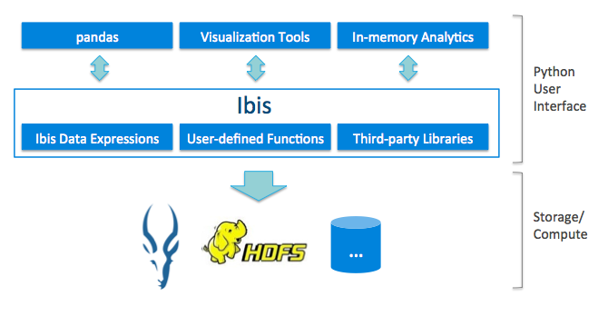

Slide 99
Ibis/Impala Joint Roadmap
More natural data modeling
Complex types support
Integration with full Python data ecosystem
Advanced analytics + machine learning
Enable use of performance computing tools
User extensibility with native performance
In-memory columnar format
Python-to-LLVM IR compilation
Workflow and usability tools

Slide 100
Academic Challenge
Code at github (https://github.com/cloudera/Impala/)
Impala Developer Docker Images & Chef scripts
https://registry.hub.docker.com/u/cloudera/impala-dev/
Minimal (7GB) — ready to compile, latest code
Default (33GB) — includes test data, e.g. TPC-H
Shout out to Spyros Blanas (Ohio State)
http://web.cse.ohio-state.edu/~sblanas/5242/
Impala JIRAs, ramp-up tasks

Slide 101

IBM Big SQL

Slide 102

Big SQL – Architecture
Head (coordinator) node
Compiles and optimizes the query
Coordinates the execution of the query
Big SQL worker processes reside on compute nodes (some or all)
Worker nodes stream data between each other as needed
Mgmt Node
Mgmt Node
Mgmt Node
Mgmt Node
Hive Metastore
Big SQL
Name Node
Job Tracker
•••
Compute Node
Compute Node
Compute Node
Compute Node
Task Tracker
Data Node
Big SQL
Task Tracker
Data Node
Big SQL
Task Tracker
Data Node
Big SQL
•••
Task Tracker
Data Node
Big SQL
HDFS

Slide 103
Big SQL – Architecture (cont.)
For common table formats a native I/O engine is utilized
e.g. delimited, RC, SEQ, Parquet, …
For all others, a java I/O engine is used
Maximizes compatibility with existing tables
Allows for custom file formats and SerDe's
All Big SQL built-in functions are native code
Customer built UDF's can be developed in C++ or Java
Mgmt Node
Big SQL
Compute Node
Task Tracker
Data Node
Big SQL
Big SQL Worker
Runtime
Native UDFs
Java UDFs
Native I/O Engine
Java I/O Engine
103

Slide 104
Big SQL works with Hadoop
All data is Hadoop data
In files in HDFS
SEQ, ORC, delimited, Parquet …
Never need to copy data to a proprietary representation
All data is catalog-ed in the Hive metastore
It is the Hadoop catalog
It is flexible and extensible
104

Slide 105
Scheduler Service
The scheduler is the main RDBMS↔Hadoop service interface
Interfaces with Hive metastore for table metadata
SQL compiler ask it for some "hadoop" metadata, such as partitioning columns
Acts like the MapReduce job tracker for Big SQL
Big SQL provides query predicates for scheduler to perform partition elimination
Determines splits for each “table” involved in the query
Schedules splits on available Big SQL nodes (with best effort data locality)
Decides which I/O library to use and serves
work (splits) to them
Coordinates “commits” after INSERTs
Management Node
Mgmt Node
Big SQL
Master Node
Big SQL
Scheduler
Database Service
UDF FMP
DDL FMP
Hive Metastore
Big SQL
Worker Node
HDFS Data Node
Native I/O FMP
Java I/O FMP
UDF FMP
MRTask Tracker

Slide 106
Query Rewrite
There are many ways to express the same query
Query generators often produce suboptimal queries and don't permit "hand optimization"
Complex queries often result in redundancy, especially with views
For large data volumes optimal access plans more crucial as penalty for poor planning is greater
select sum(l_extendedprice) / 7.0 as avg_yearly
from temp (l_quantity, avgquantity, l_extendeprice) as
(select l_quantity, avg(l_quantity) over
(partition by l_partkey)
as avgquantity, l_extenedprice
from tpcd.lineitem, tpcd.part
where p_partkey = l_partkey
and p_brand = 'BRAND#23'
and p_container = 'MED BOX')
where l_quantity < 0.2 * avgquantity
select sum(l_extendedprice) / 7.0 avg_yearly
from tpcd.lineitem, tpcd.part
where p_partkey = l_partkey
and p_brand = 'Brand#23'
and p_container = 'MED BOX'
and l_quantity < ( select 0.2 *
avg(l_quantity) from tpcd.lineitem
where l_partkey = p_partkey);
Query correlation eliminated
Lineitem table accessed only once
Execution time reduced in half!
Notes:
Rewriting a given SQL query into a semantically equivalent form that may be processed more efficiently
106

Slide 107
Cost-based Optimization
|
2.66667e-08
HSJOIN
( 7)
1.1218e+06
8351
/--------+--------\
5.30119e+08 3.75e+07
BTQ NLJOIN
( 8) ( 11)
948130 146345
7291 1060
| /----+----\
5.76923e+08 1 3.75e+07
LTQ GRPBY FILTER
( 9) ( 12) ( 20)
855793 114241 126068
7291 1060 1060
| | |
5.76923e+08 13 7.5e+07
TBSCAN TBSCAN BTQ
( 10) ( 13) ( 21)
802209 114241 117135
7291 1060 1060
| | |
7.5e+09 13 5.76923e+06
TABLE: TPCH5TB_PARQ TEMP LTQ
ORDERS ( 14) ( 22)
Q1 114241 108879
1060 1060
| |
13 5.76923e+06
DTQ TBSCAN
( 15) ( 23)
114241 108325
1060 1060
| |
1 7.5e+08
GRPBY TABLE: TPCH5TB_PARQ
( 16) CUSTOMER
114241 Q5
1060
|
1
LTQ
( 17)
114241
1060
|
1
GRPBY
( 18)
114241
1060
|
5.24479e+06
TBSCAN
( 19)
113931
1060
|
7.5e+08
TABLE: TPCH5TB_PARQ
CUSTOMER
Q2
Few extensions required to the Cost Model
Scan operator cost model extended to evaluate cost of reading from Hadoop
# of files, size of files, # of partitions, # of nodes
Data not hash partitioned on a particular columns (aka “Scattered partitioned”)
New parallel join strategy
Every node read data from HDFS, instead of one reading and broadcasting
Optimizer now knows in which subset of nodes the data resides => better costing!
Sophisticated statistics for cardinality estimation
Notes:
107

Slide 108
Statistics
Big SQL utilizes Hive statistics collection with some extensions:
Additional support for column groups, histograms and frequent values
Automatic determination of partitions that require statistics collection vs. explicit
Partitioned tables: added table-level versions of NDV, Min, Max, Null count, Average column length
Hive catalogs as well as database engine catalogs are also populated
We are restructuring the relevant code for submission back to Hive
Capability for statistic fabrication if no stats available at compile time
Table statistics
Cardinality (count)
Number of Files
Total File Size
Column statistics
Minimum value (all types)
Maximum value (all types)
Cardinality (non-nulls)
Distribution (Number of Distinct Values NDV)
Number of null values
Average Length of the column value (all types)
Histogram - Number of buckets configurable
Frequent Values (MFV) – Number configurable
Column group statistics

Slide 109

Big SQL supports HBase tables
Big SQL with HBase – basic operations
Create tables and views
LOAD / INSERT data
Query data with full SQL breadth
HBase-specific design points
Column mapping
Dense / composite columns
FORCE KEY UNIQUE option
Secondary indexes
. . . .

Slide 110
Big SQL works under YARN
Big SQL integrates with YARN via the Slider project
YARN chooses suitable hosts for Big SQL worker nodes
Big SQL resources are accounted for by YARN
Size of the Big SQL cluster may dynamically grow or shrink as needed
Configured by user (not by installation default)
More Big SQL workers are added when more resources are needed
When demand wears off, Big SQL workers are shut down
Data Access
Pig
Hive
SPARK
MapReduce
Big SQL
YARN
HDFS
Data Management

Slide 111
Summary
Big SQL provides rich, robust, standards-based SQL support for data stored in HDFS and HBase
Uses IBM common client ODBC/JDBC drivers
Big SQL fully integrates with SQL applications and tools
Existing queries run with no or few modifications*
Existing JDBC and ODBC compliant tools can be leveraged
Big SQL provides faster and more reliable performance
Big SQL uses more efficient access paths to the data
Big SQL is optimized to more efficiently move data over the network
Big SQL is capable of executing all 22 TPC-H and all 99 TPC-DS queries without modification
Big SQL provides and enterprise grade data management
Security, Auditing, workload management …
Notes:
There are three key messages around BigInsights’ Big SQL capability:
First, is that Big SQL is standards compliant. We support standard SQL that’s used across most relational database systems today, and ANSI SQL as well. In addition, we include ODBC and JDBC drivers that actually behave like drivers from relational systems.
Second, with a standard interface and driver support, Big SQL enables deep integration with existing SQL applications and tooling. Moreover it enables businesses to leverage existing SQL skills so that many more people can get value out of data stored in Hadoop.
Third and finally, Big SQL provides faster and more reliable query performance. It accomplishes this by choosing execution paths that are appropriate for the nature of the query and the underlying data.
111

Slide 112
SparkSQL

Slide 113
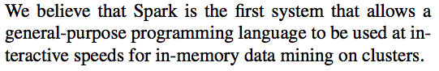
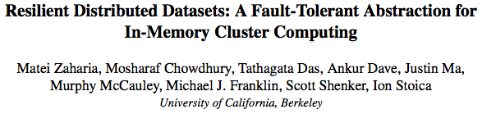
What is so great about Spark?
From:

Slide 114
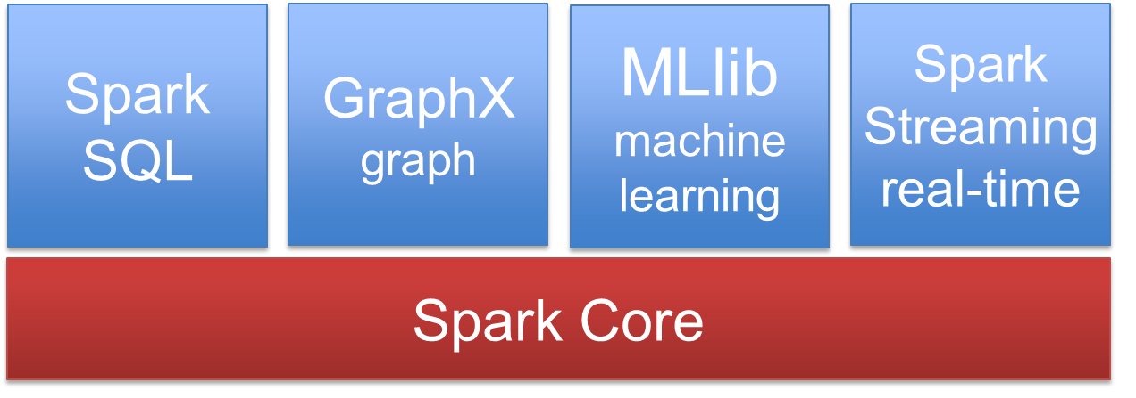
OK, but what exactly is Spark?
Distributed data analytics engine, generalizing Map Reduce
Core engine, with streaming, SQL, machine learning, and graph processing modules

Slide 115
Spark Core: RDDs, Transformations & Actions
RDDs
Distributed collection of objects
Can be cached in memory
Built via parallel transformations (map, filter, …)
Automatically rebuilt on failure based on lineage
DAGs of RDDs and Transformations can be (lazily) executed via actions
Examples: Export to HDFS, count number of objects

Slide 116
Spark’s DAG Execution
Notes:
http://www.slideshare.net/alanfgates/strata-stingertalk-oct2013 Slide 22 mentions Stripe-based Input Splits
Hive-5632 (Eliminate splits based on SARGs using stripe statistics in ORC): Includes a comment from committer:
ORC already stores hierarchical min/max metadata. At the lowest level, ORC stores min/max for every 10,000 rows (called as rowgroups). The size of the rowgroup can be configured using the table property "orc.row.index.stride". At a higher level, HIVE-5562 adds min/max metadata to stripe level. There is also file level min/max values as well at the file footer.Stripe levels stats are stored in file footer, stripes that doesn't satisfy the predicates can be skipped while computing the splits.

Slide 117



Why Application Developers love Spark
Building a real-world big data application without and with Spark:
HDFS read
ETL
HDFS write
HDFS read
train
HDFS write
HDFS read
query
HDFS write
…
With Spark:
Interactive analysis
HDFS read
ETL
train
query
HDFS

Slide 118
An Example App
Raw JSON Tweets
Streaming
SQL
Machine Learning

Slide 119
import org.apache.spark.sql._
val ctx = new org.apache.spark.sql.SQLContext(sc)
val tweets = sc.textFile("hdfs:/twitter")
val tweetTable = JsonTable.fromRDD(sqlContext, tweets, Some(0.1))
tweetTable.registerAsTable("tweetTable")
ctx.sql("SELECT text FROM tweetTable LIMIT 5").collect.foreach(println)
ctx.sql("SELECT lang, COUNT(*) AS cnt FROM tweetTable \
GROUP BY lang ORDER BY cnt DESC LIMIT 10").collect.foreach(println)
val texts = sql("SELECT text FROM tweetTable").map(_.head.toString)
def featurize(str: String): Vector = { ... }
val vectors = texts.map(featurize).cache()
val model = KMeans.train(vectors, 10, 10)
sc.makeRDD(model.clusterCenters, 10).saveAsObjectFile("hdfs:/model")
val ssc = new StreamingContext(new SparkConf(), Seconds(1))
val model = new KMeansModel(
ssc.sparkContext.objectFile(modelFile).collect())
// Streaming
val tweets = TwitterUtils.createStream(ssc, /* auth */)
val statuses = tweets.map(_.getText)
val filteredTweets = statuses.filter {
t => model.predict(featurize(t)) == clusterNumber
}
filteredTweets.print()
ssc.start()
Fits on one slide

Slide 120
Why SparkSQL?
SQL, SQL, SQL, …
Databricks says that 100% of their customers use some SQL
Schema is very useful
Even in complex pipelines that process a lot of un/semi-structured data
Separation of logical from physical plan is critical for performance and scalability
Notes:
http://www.slideshare.net/alanfgates/strata-stingertalk-oct2013 Slide 22 mentions Stripe-based Input Splits
Hive-5632 (Eliminate splits based on SARGs using stripe statistics in ORC): Includes a comment from committer:
ORC already stores hierarchical min/max metadata. At the lowest level, ORC stores min/max for every 10,000 rows (called as rowgroups). The size of the rowgroup can be configured using the table property "orc.row.index.stride". At a higher level, HIVE-5562 adds min/max metadata to stripe level. There is also file level min/max values as well at the file footer.Stripe levels stats are stored in file footer, stripes that doesn't satisfy the predicates can be skipped while computing the splits.

Slide 121
Plan Optimization & Execution
Logical
Optimization
Physical
Planning
Code
Generation
Analysis
SQL AST
Unresolved Logical Plan
Logical Plan
Optimized Logical Plan
Physical Plans
Selected Physical Plan
RDDs
Cost Model
DataFrame
Catalog
DataFrames and SQL share the same optimization/execution pipeline

Slide 122
DataFrame
A distributed collection of rows organized into named columns
An abstraction for selecting, filtering, aggregating and plotting structured data (cf. R, Pandas, Ibis)

Slide 123
Catalyst Optimizer: Tree Transformations
Developers express tree transformations as PartialFunction[TreeType,TreeType]
If the function does apply to an operator, that operator is replaced with the result.
When the function does not apply to an operator, that operator is left unchanged.
The transformation is applied recursively to all children.

Slide 124
Prior Work: Optimizer Generators
Volcano / Cascades:
Create a custom language for expressing rules that rewrite trees of relational operators.
Build a compiler that generates executable code for these rules.

Slide 125
An Example Catalyst Transformation
Find filters on top of projections.
Check that the filter can be evaluated without the result of the project.
If so, switch the operators.

Slide 126
Filter Push Down Transformation
val newPlan = queryPlan transform {
case f @ Filter(_, p @ Project(_, grandChild))
if(f.references subsetOf grandChild.output) =>
p.copy(child = f.copy(child = grandChild)
}

Slide 127
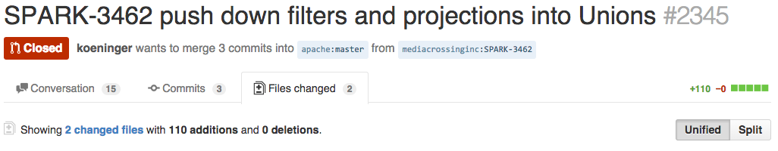
Community-Contributed Transformations
110 line patch took this user’s query from “never finishing” to 200s.

Slide 128
Project Tungsten: Getting Spark to Run Well on the JVM
Overcoming JVM limitations:
Memory Management and Binary Processing: leveraging application semantics to manage memory explicitly and eliminate the overhead of JVM object model and garbage collection
Cache-aware computation: algorithms and data structures to exploit memory hierarchy
Code generation: using code generation to exploit modern compilers and CPUs

Slide 129
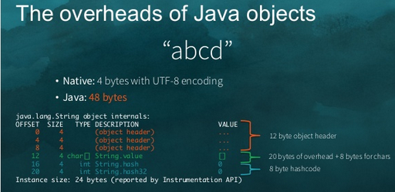

Slide 130
Use sun.misc.Unsafe
JVM internal API
Can manipulate memory without safety checks

Slide 131
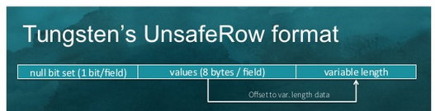
Null bits
Inline fixed-length values
Align on 8-byte word boundaries

Slide 132
Apache Phoenix

Slide 133
The Phoenix Approach
SQL compiler and execution engine for HBase
Query engine transforms SQL into native HBase APIs: put, delete, parallel scans (instead of, say, MapReduce)
Supports features not provided by HBase: Secondary Indexing, Multi-tenancy, simple Hash Join, etc.

Slide 134
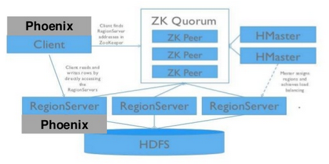
Phoenix Architecture

Slide 135
Open (Research) Challenges

Slide 136
Challenge 1: Query optimization
Cost-based optimizer relies on
Statistics over base relations
Formulas for cost estimation
Rules for plan enumeration
Problems:
Stats not reliable, do not own the data
Prominent use of UDFs
Independence assumption between predicates do not hold
More nested data, harder to estimate selectivities
Bad plans over big data may run “forever”
Defer more cost-based decisions to run-time; robust, adaptive query optimization

Slide 137
Challenge 2: Multi-framework environment
No single framework owns the data!
Multiple frameworks, with different resource requirements
Streaming
SQL
Graph
ETL and batch processing
Machine learning
Spark/MR/Tez/..
Hadoop Yarn
HDFS, S3
How to share the data?
How to share resources?
How to work together seamlessly?

Slide 138

Challenge 3: Transactions and analytics in one system
HDFS is a problem for transactional workloads
Workarounds do not lend itself to high-performance OLAP
Object-stores
Interesting combinations are emerging
Hive LLAP + Phoenix, Splice Machine + Spark
Need more tightly integrated solutions
Need an updatable, fast, distributed file system

Slide 139
References
http://www.slideshare.net/enissoz/hbase-and-hdfs-understanding-filesystem-usage
https://www.mapr.com/blog/in-depth-look-hbase-architecture
Apache Drill. http://drill.apache.org/.
Apache Phoenix. http://phoenix.apache.org/.
Hive on spark. https://cwiki.apache.org/confluence/display/Hive/Hive+on+Spark .
Splice machine. http://www.splicemachine.com/.
Teradata query grid. http://www.teradata.com/Teradata- QueryGrid/#tabbable=0&tab1=0&tab2=0.
M. Kornacker, A. Behm, V. Bittorf, T. Bobrovytsky, C. Ching, A. Choi, J. Erickson, M. Grund, D. Hecht, M. Jacobs, I. Joshi, L. Kuff, D. Kumar, A. Leblang, N. Li, I. Pandis, H. Robinson, D. Rorke, S. Rus, J. Russell, D. Tsirogiannis, S. Wanderman-Milne, and M. Yoder. “Impala: A Modern, Open-Source SQL Engine for Hadoop.” In Proc. CIDR, 2015.
Y. Huai, A. Chauhan, A. Gates, G. Hagleitner, E. N. Hanson, O. O'Malley, J. Pandey, Y. Yuan, R. Lee, and X. Zhang. “Major technical advancements in apache hive.” In Proc. SIGMOD, 2014.

Slide 140
References (cont.)
A. Ailamaki, D. J. DeWitt, M. D. Hill, and M. Skounakis. “Weaving Relations for Cache Performance.” In Proc. of the 27th International Conference on Very Large Data Bases, 2001.
Y. He, R. Lee, Y. Huai, Z. Shao, N. Jain, X. Zhang, and Z. Xu. “RCFile: A fast and space-efficient data placement structure in MapReduce-based warehouse systems.” In Proc. of ICDE, 2011.
H. Lim, H. Herodotou, and S. Babu. “Stubby: a transformation-based optimizer for MapReduce workflows.” PVLDB, 2012.
T. Neumann. “Efficiently compiling efficient query plans for modern hardware.” PVLDB, 2011.
D. Simmen, E. Shekita, and T. Malkemus. “Fundamental techniques for order optimization.” In Proc. of ACM SIGMOD, 1996.
A. Thusoo, J. S. Sarma, N. Jain, Z. Shao, P. Chakka, N. Zhang, S. Anthony, H. Liu, and R. Murthy.” Hive - A Petabyte Scale Data Warehouse Using Hadoop.” In ICDE, 2010.
T. Willhalm, N. Popovici, Y. Boshmaf, H. Plattner, A. Zeier, and J. Schaffner. “SIMD-scan: ultra fast in- memory table scan using on-chip vector processing units.” PVLDB, 2, 2009.

Slide 141
References (cont.)
V. Raman, G. Attaluri, R. Barber, N. Chainani, D. Kalmuk, V. KulandaiSamy, J. Leenstra, S. Light- stone, S. Liu, G. M. Lohman, T. Malkemus, R. Mueller, I. Pandis, B. Schiefer, D. Sharpe, R. Sidle, A. Storm, and L. Zhang. “DB2 with BLU Acceleration: So much more than just a column store.” PVLDB, 6, 2013.
A. Abouzeid, K. Bajda-Pawlikowski, D. J. Abadi, A. Rasin, and A. Silberschatz. “HadoopDB: An Architectural Hybrid of MapReduce and DBMS Technologies for Analytical Workloads.” PVLDB, 2009.
A. Abouzied, D. J. Abadi, and A. Silberschatz. “Invisible loading: Access-driven data transfer from raw files into database systems.” In EDBT, 2013.
M. Amburst, R. S. Xin, C. Lian, Y. Huai, D. Liu, J. K. Bradley, X. Meng, T. Kaftan, M. J. Franklin, A. Ghodsi, and M. Zaharia. “Spark SQL: Relational data processing in Spark.” In ACM SIGMOD, 2015.
V. K. Vavilapalli, A. C. Murthy, C. Douglas, S. Agarwal, M. Konar, R. Evans, T. Graves, J. Lowe, H. Shah, S. Seth, B. Saha, C. Curino, O. O’Malley, S. Radia, B. Reed, and E. Baldeschwieler. Apache Hadoop YARN: Yet another resource negotiator. In SOCC, 2013.

Slide 142
References (cont.)
K. Bajda-Pawlikowski, D. J. Abadi, A. Silberschatz, and E. Paulson. “Efficient processing of data warehousing queries in a split execution environment.” In ACM SIGMOD, 2011.
P. Boncz. Vortex: Vectorwise goes Hadoop. http://databasearchitects.blogspot.com/2014/05/vectorwise- goes-hadoop.html.
L. Chang, Z. Wang, T. Ma, L. Jian, L. Ma, A. Goldshuv, L. Lonergan, J. Cohen, C. Welton, G. Sherry, and M. Bhandarkar. “HAWQ: A massively parallel processing SQL engine in hadoop.” In ACM SIGMOD, 2014.
G. Graefe. “Encapsulation of parallelism in the Volcano query processing system.” In ACM SIGMOD, 1990.
S. Gray, F. Özcan, H. Pereyra, B. van der Linden, and A. Zubiri. “IBM Big SQL 3.0: SQL-on-Hadoop without compromise.” http://public.dhe.ibm.com/common/ ssi/ecm/en/sww14019usen/SWW14019USEN.PDF, 2014.
F.Özcan, D. Hoa, K. S. Beyer, A. Balmin, C. J. Liu, and Y. Li. “Emerging trends in the enterprise data analytics: Connecting Hadoop and DB2 warehouse.” In ACM SIGMOD, 2011.

Slide 143
References (cont.)
S. Melnik, A. Gubarev, J. J. Long, G. Romer, S. Shivakumar, M. Tolton, and T. Vassilakis. “Dremel: Interactive analysis of web-scale datasets.” PVLDB, 2010.
S. Padmanabhan, T. Malkemus, R. C. Agarwal, and A. Jhingran. “Block oriented processing of relational database operations in modern computer architectures.” In ICDE, 2001.
B. Saha, H. Shah, S. Seth, G. Vijayaraghavan, A. Murthy, and C. Curino. “Apache Tez: A unifying framework for modeling and building data processing applications.” In ACM SIGMOD, 2015.
P. Seshadri, H. Pirahesh, and T. Y. C. Leung. “Complex query decorrelation.” In ICDE, 1996.
A. Floratou, U. F. Minhas, and F. Özcan. “SQL-on- Hadoop: Full circle back to shared-nothing database architectures.” PVLDB 7(12), 2014.
M. Traverso. Presto: Interacting with petabytes of data at Facebook. https://www.facebook.com/notes/facebook- engineering/presto-interacting-with-petabytes-of-data- at-facebook/10151786197628920.
S. Wanderman-Milne and N. Li. Runtime code generation in Cloudera Impala. IEEE Data Eng. Bull., 2014.

Slide 144
References (cont.)
R. S. Xin, J. Rosen, M. Zaharia, M. J. Franklin, S. Shenker, and I. Stoica. “Shark: SQL and rich analytics at scale.” In ACM SIGMOD, 2013.
M. Zaharia, M. Chowdhury, M. J. Franklin, S. Shenker, and I. Stoica. “Spark: Cluster computing with working sets.” In HotCloud, 2010.
C. Zuzarte, H. Pirahesh, W. Ma, Q. Cheng, L. Liu, and K. Wong. “WinMagic : Subquery elimination using window aggregation.” In ACM SIGMOD, 2003.
F. Chang, J. Dean, S. Ghemawat, W. C. Hsieh, D. A. Wallach, M. Burrows, T. Chandra, A. Fikes, and R. Gruber. “Bigtable: A Distributed Storage System for Structured Data.”, In OSDI 2006
B. Chattopadhyay, L. Lin, W. Liu, S. Mittal, P. Aragonda, V. Lychagina, Y. Kwon, and M. Wong. “Tenzing: A SQL Implementation on the MapReduce Framework.” In VLDB 2011.
T. Nykiel, M. Potamias, C. Mishra, G. Kollios, and N. Koudas. “MRShare: Sharing Across Multiple Queries in MapReduce.” In VLDB 2010.

Slide 145
References (cont.)
G. Wang and C.-Y. Chan. “Multi-Query Optimization in MapReduce Framework.” In VLDB, 2013.
F. Afrati and J. Ullman. “Optimizing Multiway Joins in a Map-Reduce Environment.” In TKDE 2011.
Y. Kwon, M. Balazinska, B. Howe, and J. Rolia. “SkewTune: Mitigating Skew in MapReduce Applications.” In SIGMOD 2012.
M. Eltabakh, F. Özcan, Y. Sismanis, P. J. Haas, H. Pirahesh, and J. Vondrak, “Eagle-eyed elephant: split-oriented indexing in Hadoop”, in EDBT 2014.
M. Eltabakh, Y. Tian, F. Özcan, R. Gemulla, A. Krettek, and J. McPherson, “CoHadoop: Flexible Data Placement and Its Exploitation in Hadoop”, in PVLDB 4(9), 2011.
J. Shi, Y. Qiu, U. F. Minhas, L. Jiao, C. Wang, B. Reinwald, and F. Özcan, “Clash of the Titans: MapReduce vs. Spark for Large Scale Data Analytics” in PVLDB 8(13), 2015
J. Dittrich, J-A. Quiane-Ruiz, A. Jindal, Y. Kargin, V. Setty, and J. Schad, “Hadoop++: Making a Yellos Elephant Run Like a Cheetah (without it even noticing)”, in PVLDB 3(1-2), 2010.

Slide 146
References (cont.)
D. Jiang, B. C. Ooi, L. Shi, and S. Wu, “The Performance of MapReduce: An In-depth Study”, in PVLDB 3(1-2), 2010.
D. J. DeWitt, R. V. Nehme, S. Shankar, J. Aguilar-Saborit, A. Avanes, M. Flasza, and J. Gramling, “Split Query Processing in Polybase”, in SIGMOD 2013.
M. Stonebraker, D. J. Abadi, D. J. DeWitt, S. Madden, E. Paulson, A. Pavlo, and A. Rasin, “MapReduce and parallel DBMSs: Friends or Foes?” CACM, 53(1):64–71, 2010.
A. Floratou, J. M. Patel, E. J. Shekita, and S. Tata, “Column-oriented Storage Techniques for MapReduce”, in PVLDB, 4(7):419–429, 2011
S. Harris, A. Sundararajan, E. Branish, and K. Chen, “Blistering Fast SQL Access to Hadoop using IBM BigInsights 3.0 with Big SQL 3.0”
S. Blanas and et al., “A comparison of join algorithms for log processing in mapreduce”, in SIGMOD 2010.

Slide 147
References (cont.)
HDFS caching, http://hadoop.apache.org/docs/current/hadoopproject-dist/hadoop-hdfs/CentralizedCacheManagement.html.
S. Babu and H. Herodotou, “Massively Parallel Databases and MapReduce Systems”, in Foundations and Trends in Databases 5(1), 2013.
N. Bruno, Y. Kwon, and M-C Wu, “Advanced Join Strategies for Large-Scale Distributed Computation”, in PVLDB 7(13), 2014
K. Karanasos, A. Balmin, M. Kutsch, F. Özcan, V. Ercegovac, C. Xia, and J. Jackson, “Dynamically optimizing queries over large scale data platforms”, in SIGMOD 2014
J. Dean, and S. Ghemawat, “MapReduce: Simplified Data Processing on Large Clusters”, in OSDI 2004.

Slide 148

Thank you!

